Slide 1
Python Tests

Slide 2
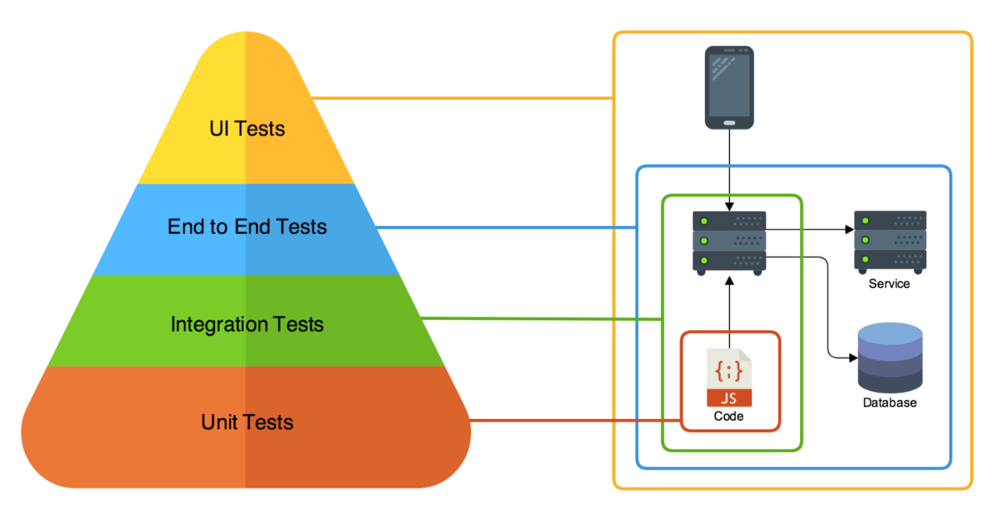
Tests - Overview

Slide 3
Advantages of Unit Testing
Any bugs are found easily and quicker
Unit testing saves time and money
Unit testing is an Integral part of extreme programming (a “test-everything-that-can-possibly-break” strategy)
Unit testing provides documentation
R2: Reusable and Reliable
Unit testing helps measure performance
Unit testing improves code coverage
Unit testing reduces code complexity

Slide 4
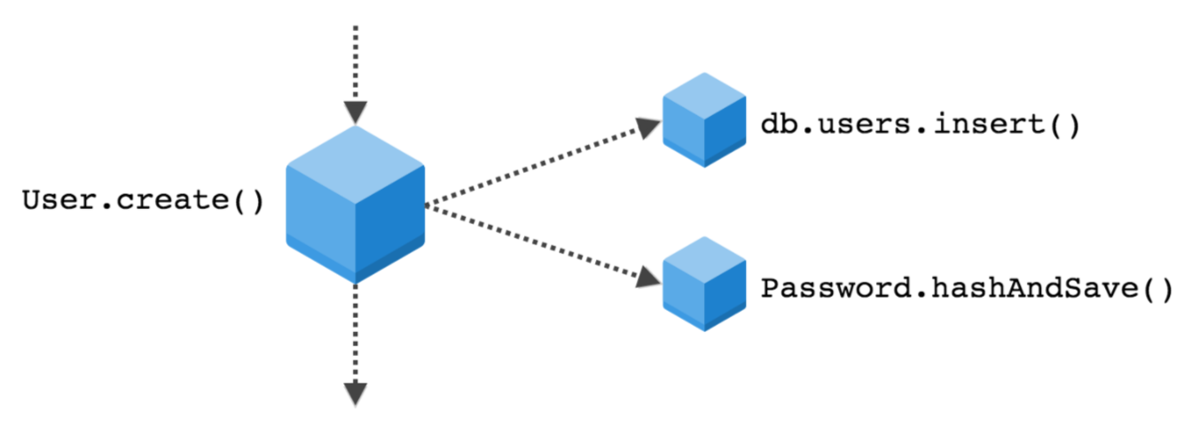
Black Box Testing
Input parameters:
Name = Laura
Username = laura
Password = njuh6795b
The goal of the test is to verify all behavior inside the “black box” by manipulating the inputs to the black box and verifying that the correct output is produced by the black box for each set of inputs.
Output parameters:
Name = Laura
Username = laura
ID =g83k720d-f73z-7n48

Slide 5
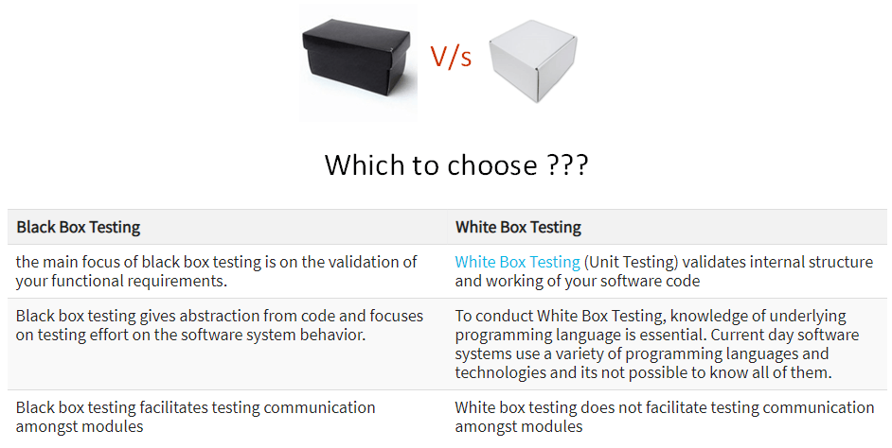
Comparison of Black Box and White Box Testing

Slide 6
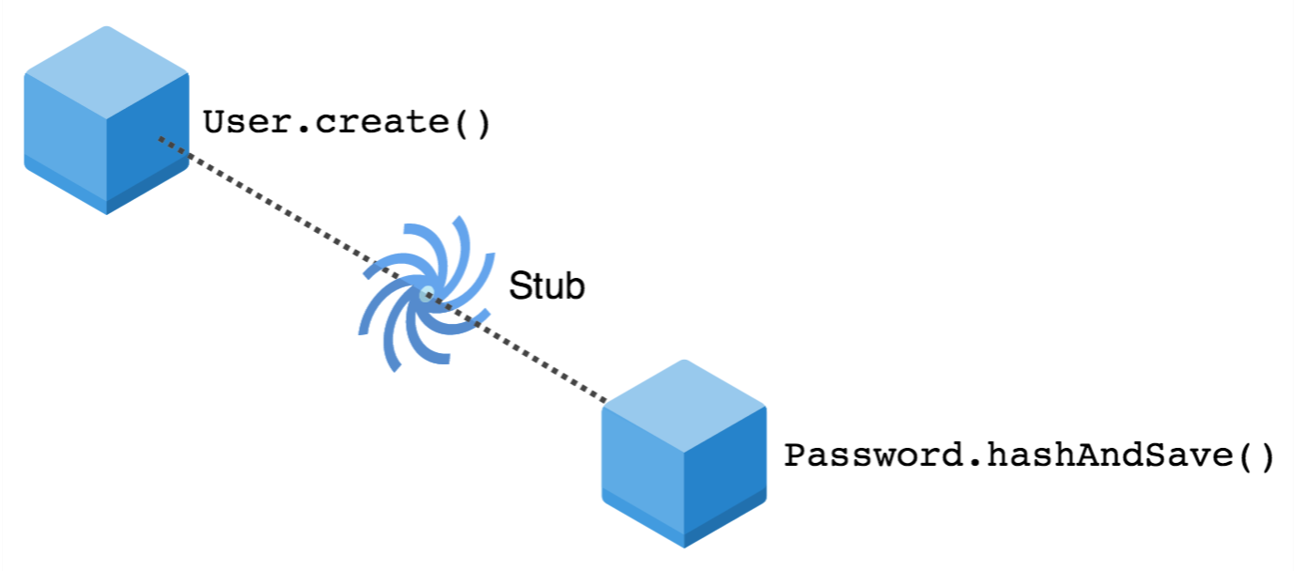
Unit Tests – Stubs & Mocks
In order to reproduce input conditions that come from side effects it is necessary to implement function stubs, also called mocks. This can be done using dependency injection
https://docs.python.org/3/library/unittest.mock.html

Slide 7
Unit Tests – Python “Unittest” library
unittest has been built into the Python standard library since version 2.1. You’ll probably see it in commercial Python applications and open-source projects.
unittest requires that:
You put your tests into classes as methods
You use a series of special assertion methods (assertEqual, assertTrue, assertFalse, assertRaises) in the unittest.TestCase class instead of the built-in assert statement

Slide 8
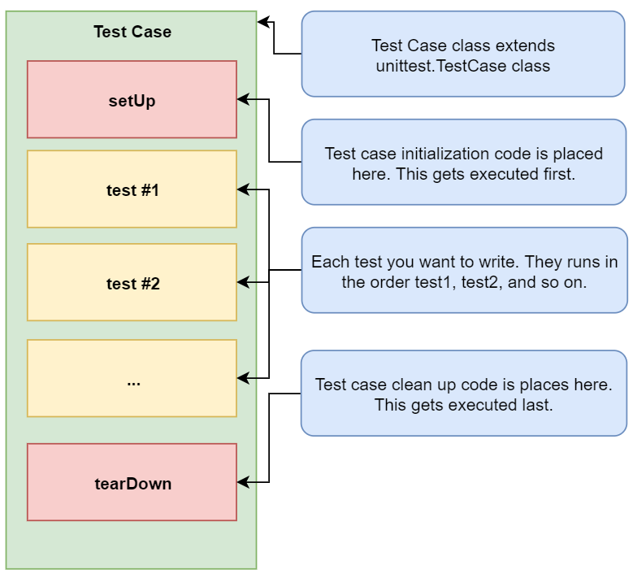
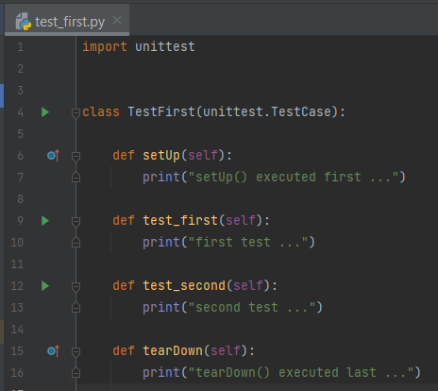
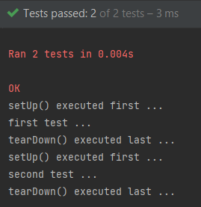
Unit Tests – Python “Unittest” library

Slide 9
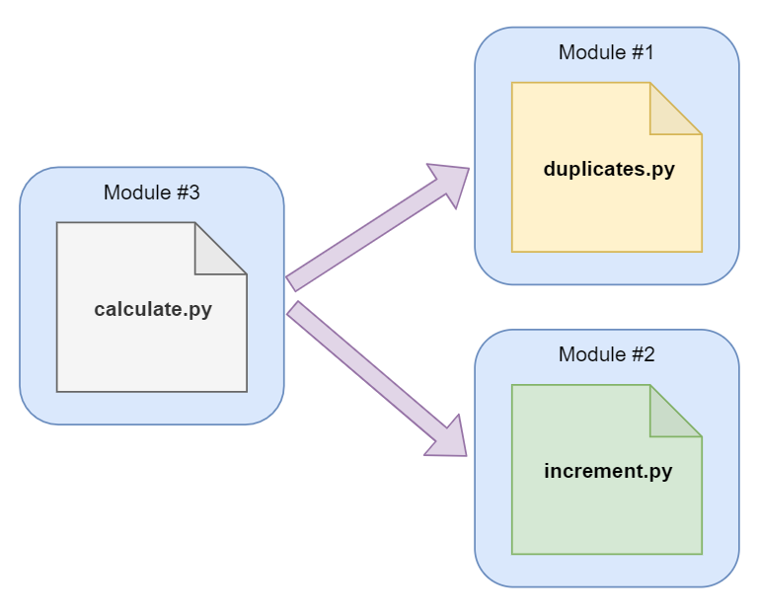
Unit Tests – Simple example

Slide 10
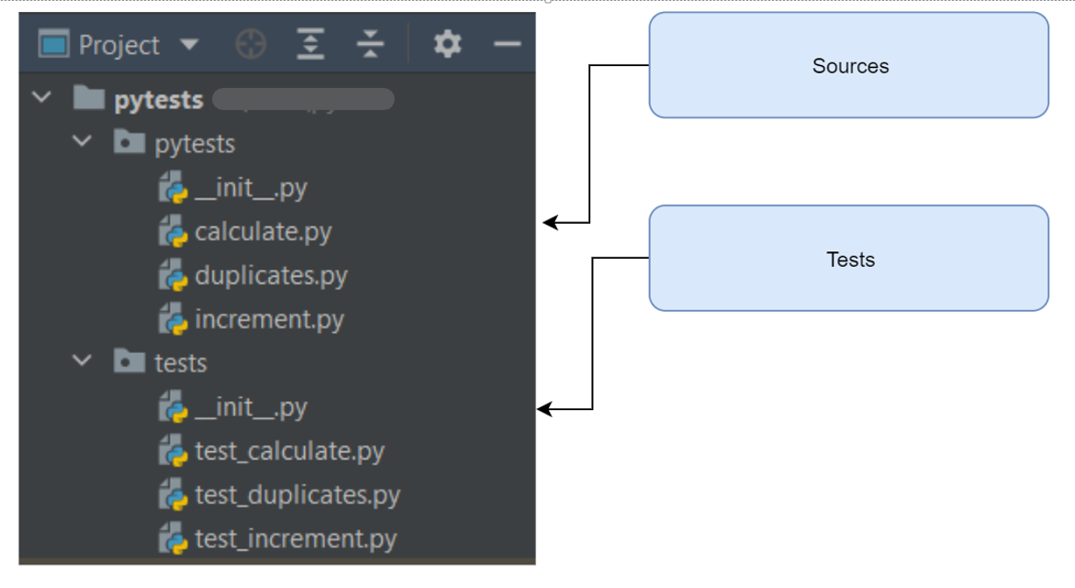
Unit Tests – Project Structure

Slide 11
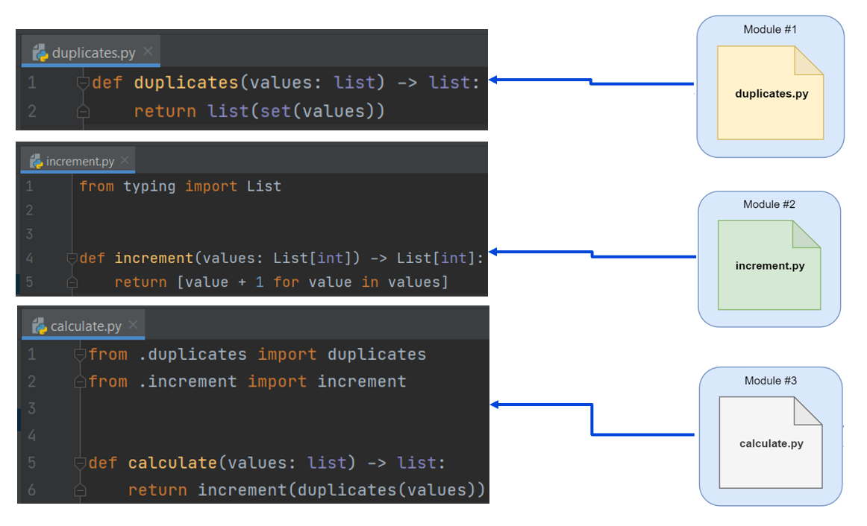
Unit Tests – Modules

Slide 12
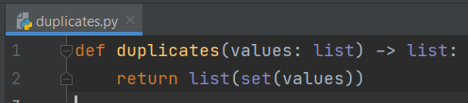
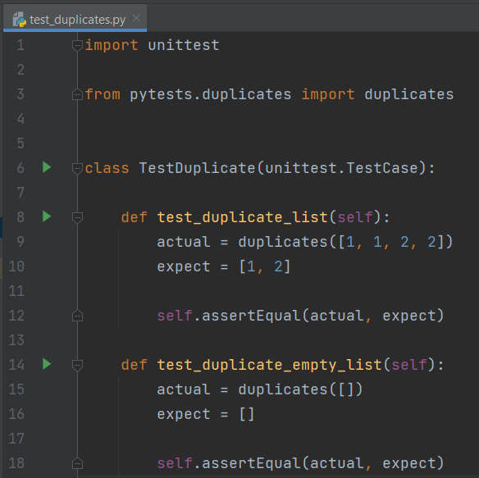
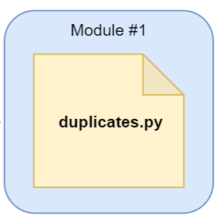
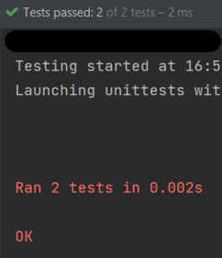
Unit Tests – Test Module #1

Slide 13
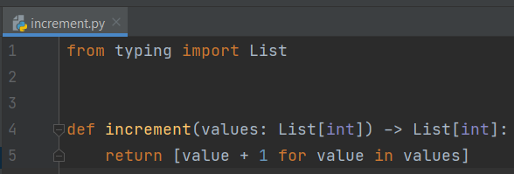
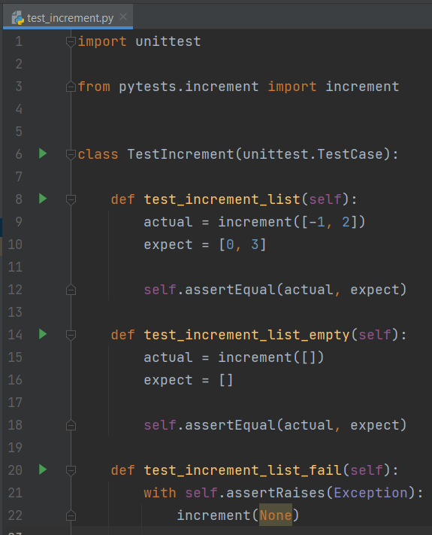
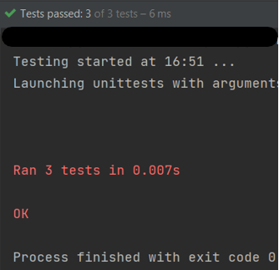
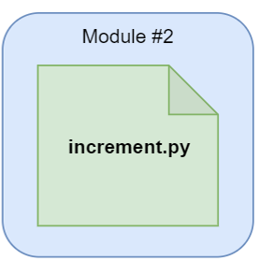
Unit Tests – Test Module #2

Slide 14
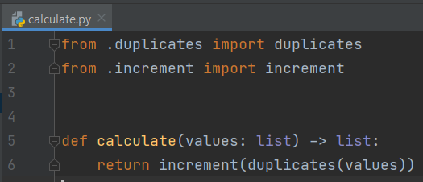
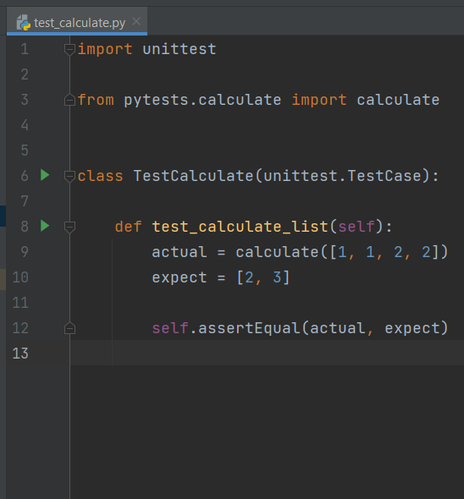
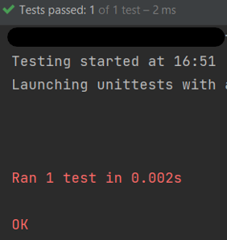
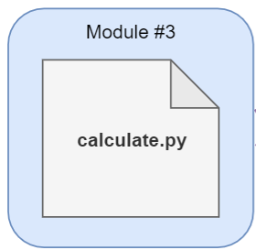
Unit Tests – Test Module #3

Slide 15
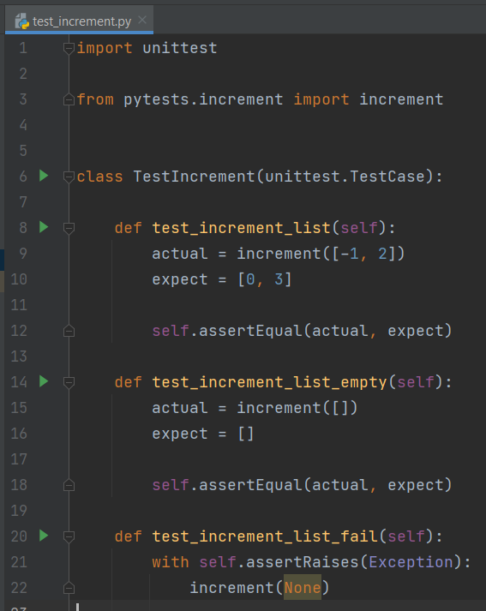
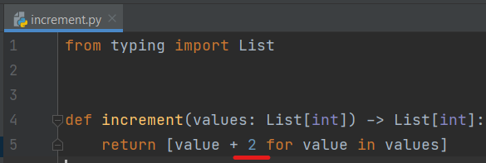
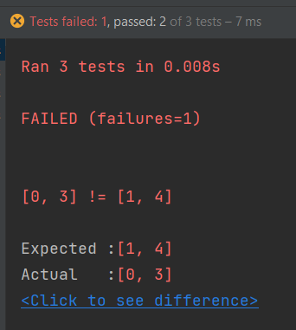
Unit Tests – Test Failure

Slide 16
RUNNing unit test
In PyCharm
import unittest class testClass (unittest.TestCase): def test_1 (self): … def test_2 (self): … def test_3 (self): … if __name__ == '__main__': unittest.main()
In Jupyter :
if __name__ == '__main__':
unittest.main(argv=['first-arg-is-ignored'], exit=False)

Slide 17
Practice EXAMPLE
1. .upper() assertEqual
2 . isupper() assertTrue, assertFalse
3. s.split(10) self.assertRaises

